Slide 1
Artificial Intelligence
First-Order Logic
Inference in First-Order Logic

Slide 2
First-Order Logic: Better choice for Wumpus World
Propositional logic represents facts
First-order logic gives us
  Objects
  Relations: how objects relate to each other
  Properties: features of an object
  Functions: output an object, given others

Slide 3
Syntax and Semantics
Propositional logic has the following:
  Constant symbols: book, A, cs327
  Predicate symbols: specify that a given relation holds
    Example:
      Teacher(CS327sec1, Barb)
      Teacher(CS327sec2, Barb)
    “Teacher” is a predicate symbol
  For a given set of constant symbols, relation may or may not hold

Slide 4
Syntax and Semantics
  Function Symbols
    FatherOf(Luke) = DarthVader
  Variables
    Refer to other symbols
    x, y, a, b, etc.
  In Prolog, capitalization is reverse:
    Variables are uppercase
    Symbols are lower case
  Prolog example ([user], ;)

Slide 5
Syntax and Semantics
  Atomic Sentences
    Father(Luke,DarthVader)
    Siblings(SonOf(DarthVader), DaughterOf(DarthVader))
  Complex Sentences
    and, or, not, implies, equivalence
  Equality

Slide 6

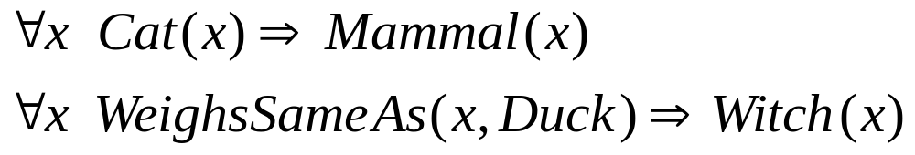


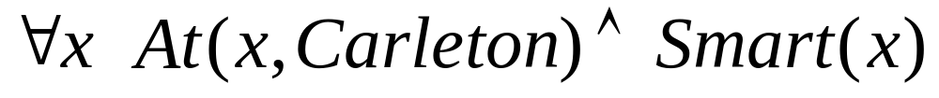
Universal Quantification
“For all, for every”:
Examples:
Usually use with
Common mistake to use

Slide 7

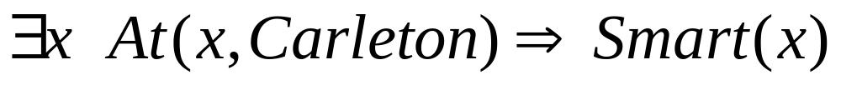
Existential Quantification
“There exists”:
Typically use with
Common mistake to use
  True if there is no one at Carleton!

Slide 8
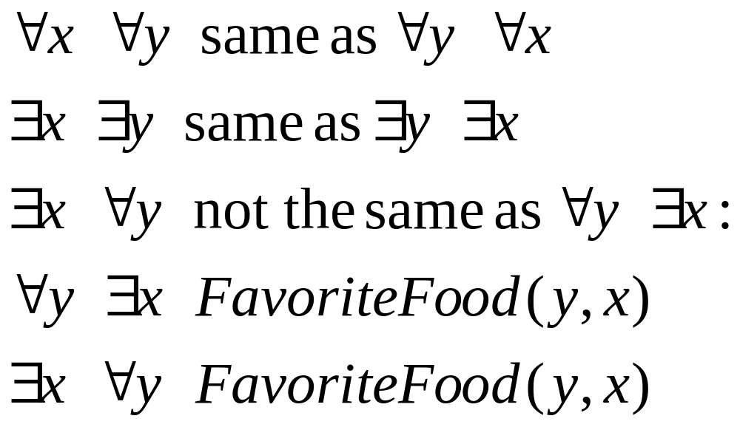
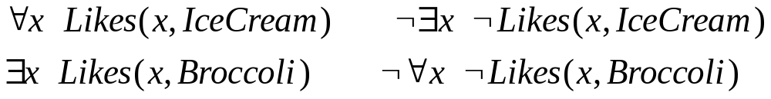
Properties of quantifiers
Can express each quantifier with the other

Slide 9
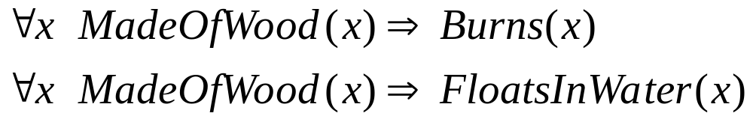
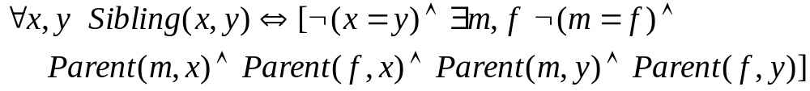
Some examples
Definition of sibling in terms of parent:

Slide 10
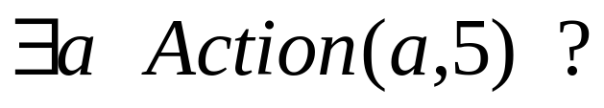
First-Order Logic in Wumpus World
Suppose an agent perceives a stench, breeze, no glitter at time t = 5:
  Percept([Stench,Breeze,None],5)
  [Stench,Breeze,None] is a list
Then want to query for an appropriate action. Find an a (ask the KB):

Slide 11
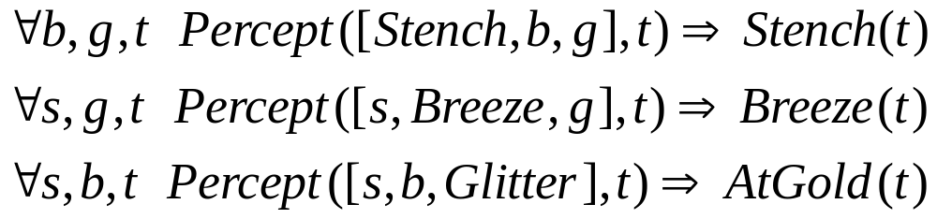
Simplifying the percept and deciding actions
Simple Reflex Agent
Agent Keeping Track of the World

Slide 12
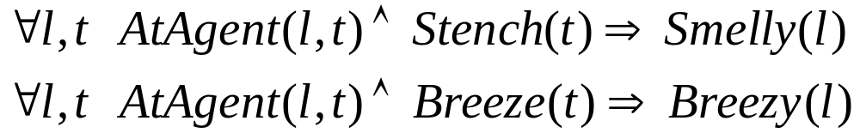
Using logic to deduce properties
Define properties of locations:
Diagnostic rule: infer cause from effect
Causal rule: infer effect from cause
Neither is sufficient: causal rule doesn’t say if squares far from pits can be breezy. Leads to definition:

Slide 13
Keeping track of the world is important
Without keeping track of state...
  Cannot head back home
  Repeat same actions when end up back in same place
  Unable to avoid infinite loops
  Do you leave, or keep searching for gold?
Want to manage time as well
  Holding(Gold,Now) as opposed to just Holding(Gold)

Slide 14
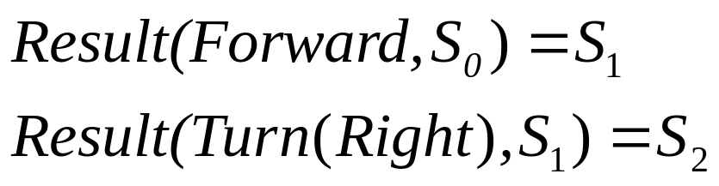
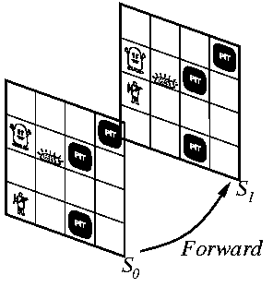
Situation Calculus
Adds time aspects to first-order logic
Result function connects actions to results

Slide 15
Describing actions
Pick up the gold!
  Stated with an effect axiom
When you pick up the gold, still have the arrow!
  Nonchanges: Stated with a frame axiom

Slide 16
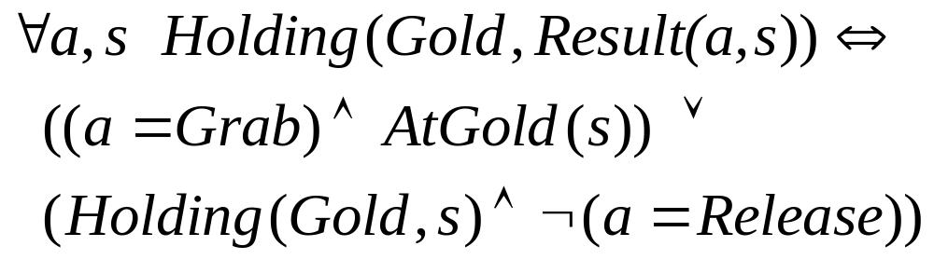
Cleaner representation: successor-state axiom
For each predicate (not action):
  P is true afterwards means
    An action made P true, OR
    P true already and no action made P false
Holding the gold:
(if there was such a thing as a release action – ignore that for our example)

Slide 17
Difficulties with first-order logic
Frame problem
  Need for an elegant way to handle non-change
  Solved by successor-state axioms
Qualification problem
  Under what circumstances is a given action guaranteed to work? e.g. slippery gold
Ramification problem
  What are secondary consequences of your actions? e.g. also pick up dust on gold, wear and tear on gloves, etc.
  Would be better to infer these consequences, this is hard

Slide 18
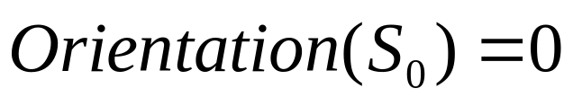
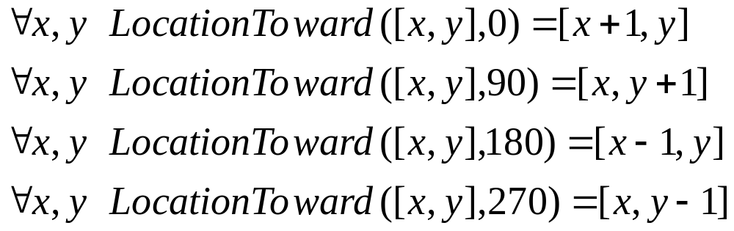
Keeping track of location
Direction (0, 90, 180, 270)
Define function for how orientation affects x,y location

Slide 19
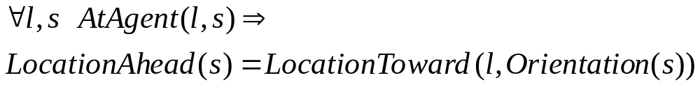
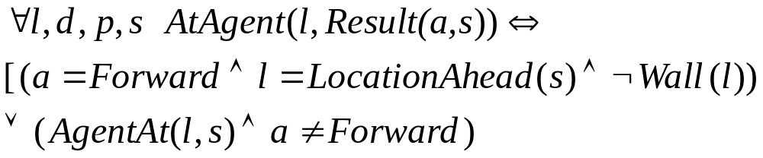
Location cont...
Define location ahead:
Define what actions do (assuming you know where wall is):

Slide 20
Primitive goal based ideas
Once you have the gold, your goal is to get back home
How to work out actions to achieve the goal?
  Inference: Lots more axioms. Explodes.
  Search: Best-first (or other) search. Need to convert KB to operators
  Planning: Special purpose reasoning systems

Slide 21
Some Prolog
Prolog is a logic programming language
Used for implementing logical representations and for drawing inference
We will do:
  Some examples of Prolog for motivation
  Generalized Modus Ponens, Unification, Resolution
  Wumpus World in Prolog

Slide 22
Inference in First-Order Logic
Need to add new logic rules above those in Propositional Logic
  Universal Elimination
  Existential Elimination
  (Person1 does not exist elsewhere in KB)
  Existential Introduction

Slide 23
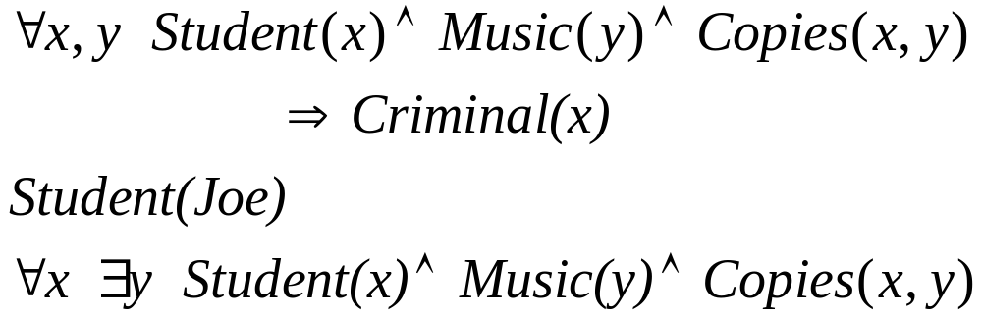
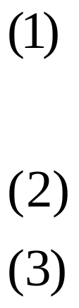
Example of inference rules
  “It is illegal for students to copy music.”
  “Joe is a student.”
  “Every student copies music.”
  Is Joe a criminal?
Knowledge Base:

Slide 24
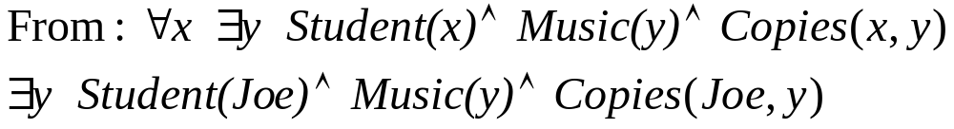
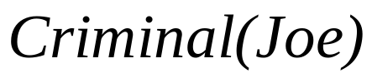
Example cont...
Universal Elimination
Existential Elimination
Modus Ponens

Slide 25
How could we build an inference engine?
Software system to try all inferences to test for Criminal(Joe)
  A very common behavior is to do:
    And-Introduction
    Universal Elimination
    Modus Ponens

Slide 26
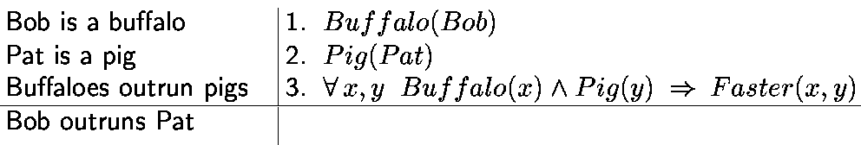
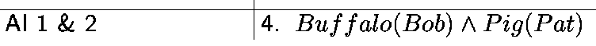
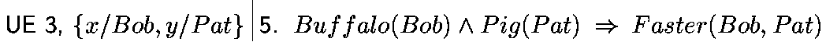
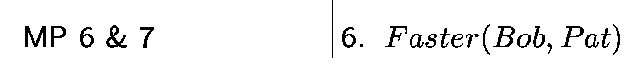
Example of this set of inferences
4 & 5
Generalized Modus Ponens does this in one shot

Slide 27
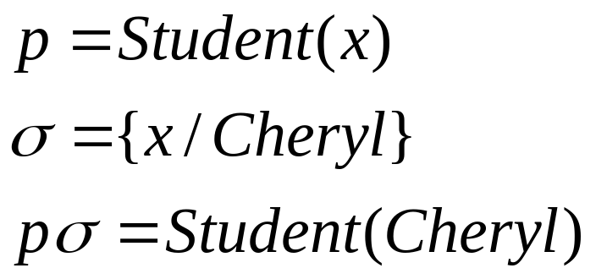
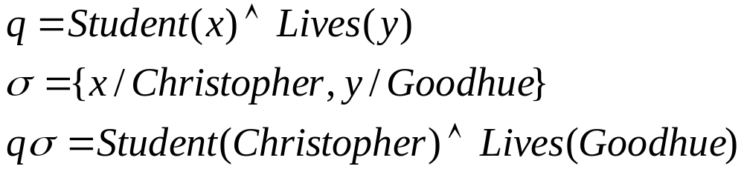
Substitution
A substitution σ in a sentence binds variables to particular values
Examples:

Slide 28
Unification
A substitution σ unifies sentences p and q if pσ = qσ.
p | q | σ
Knows(John,x) | Knows(John,Jane)
Knows(John,x) | Knows(y,Phil)
Knows(John,x) | Knows(y,Mother(y))

Slide 29
Unification
p | q | σ
Knows(John,x) | Knows(John,Jane) | {x/Jane}
Knows(John,x) | Knows(y,Phil) | {x/Phil,y/John}
Knows(John,x) | Knows(y,Mother(y)) | {y/John, x/Mother(John)}
Use unification in drawing inferences: unify premises of rule with known facts, then apply to conclusion
  If we know q, and Knows(John,x) → Likes(John,x)
  Conclude
    Likes(John, Jane)
    Likes(John, Phil)
    Likes(John, Mother(John))

Slide 30
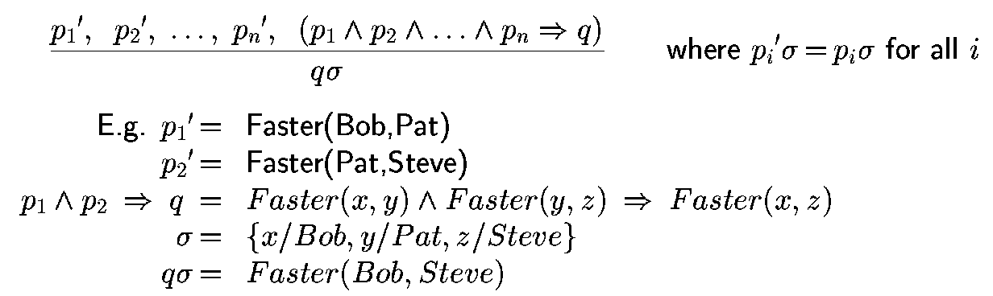
Generalized Modus Ponens
Two mechanisms for applying binding to Generalized Modus Ponens
  Forward chaining
  Backward chaining

Slide 31
Forward chaining
Start with the data (facts) and draw conclusions
When a new fact p is added to the KB:
  For each rule such that p unifies with a premise
    if the other premises are known
      add the conclusion to the KB and continue chaining

Slide 32
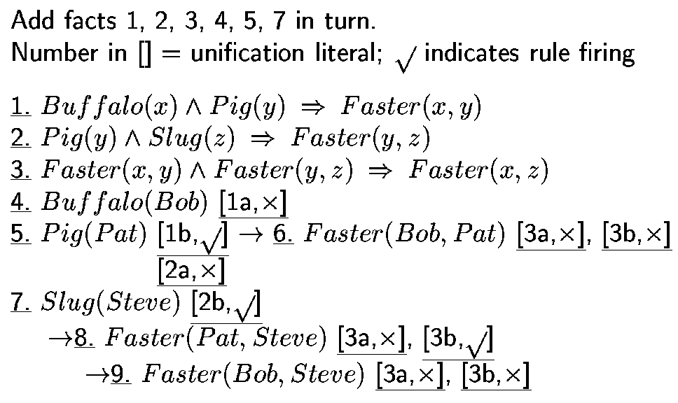
Forward Chaining Example

Slide 33
Backward Chaining
Start with the query, and try to find facts to support it
When a query q is asked:
  If a matching fact q’ is known, return unifier
  For each rule whose consequent q’ matches q
    attempt to prove each premise of the rule by backward chaining
Prolog does backward chaining

Slide 34
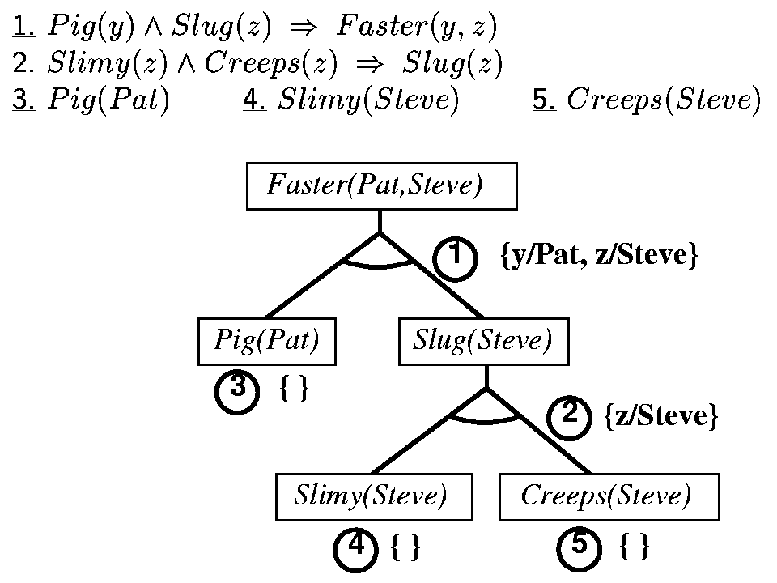
Backward Chaining Example

Slide 35
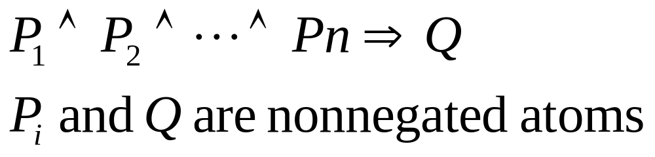
Completeness in first-order logic
A procedure is complete if and only if every sentence α entailed by KB can be derived using that procedure
Forward and backward chaining are complete for Horn clause KBs, but not in general

Slide 36
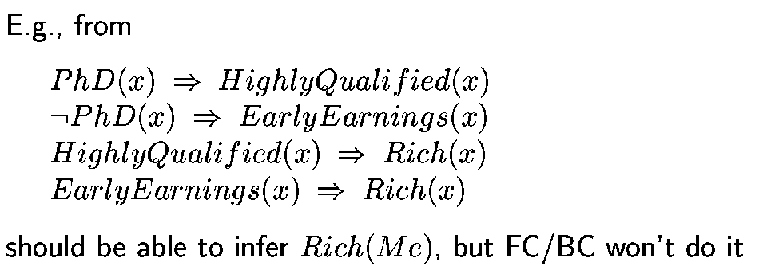
Example

Slide 37
Resolution
Resolution is a complete inference procedure for first order logic
Any sentence α entailed by KB can be derived with resolution
Catch: proof procedure can run for an unspecified amount of time
  At any given moment, if proof is not done, don’t know if infinitely looping or about to give an answer
  Cannot always prove that a sentence α is not entailed by KB
  First-order logic is semidecidable

Slide 38
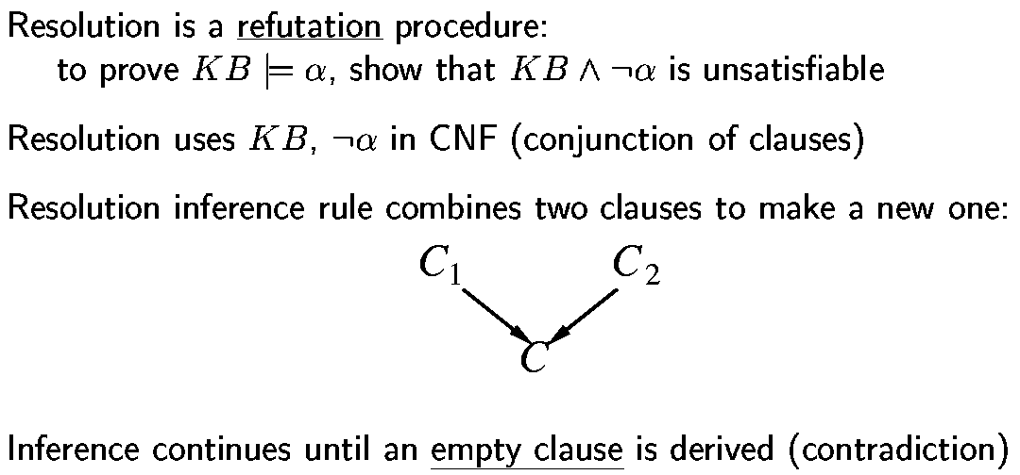
Resolution

Slide 39
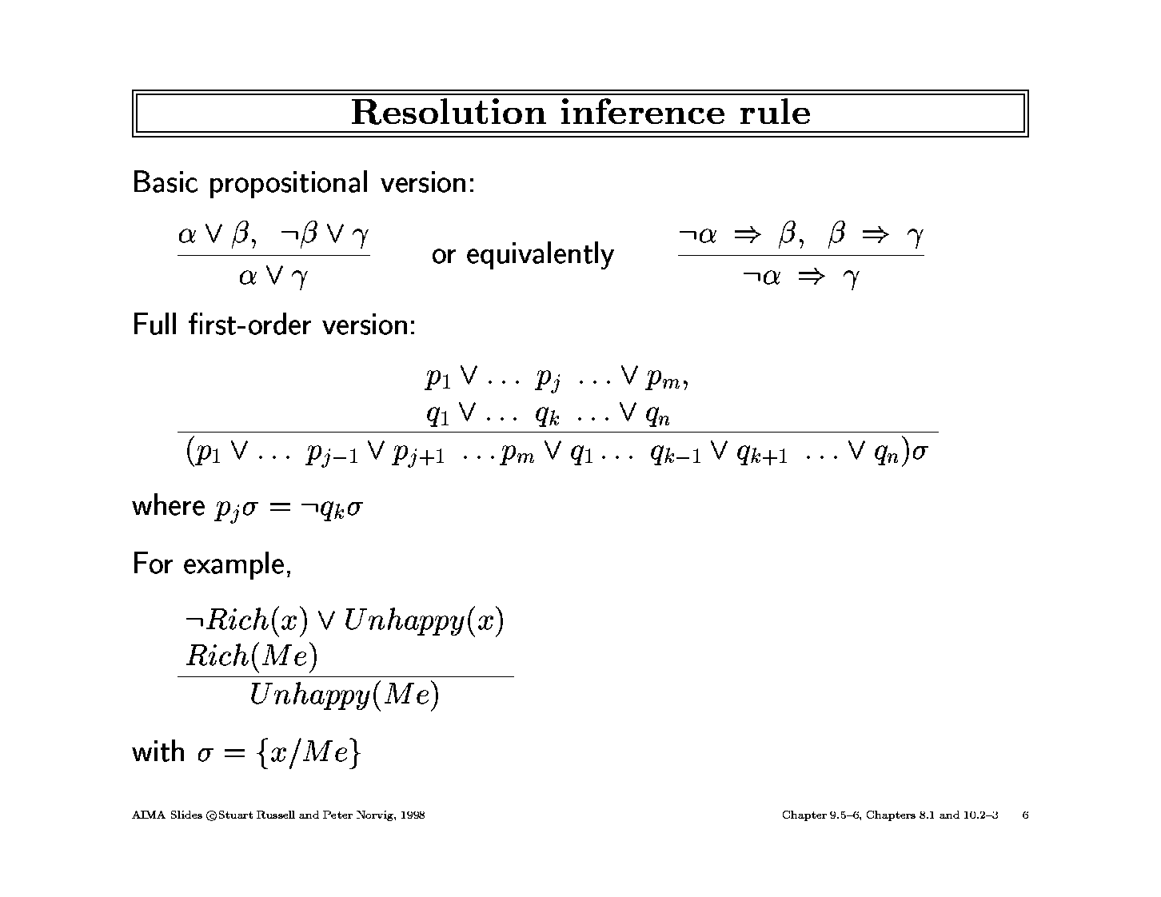
Resolution Inference Rule

Slide 40
Resolution Inference Rule
In order to use resolution, all sentences must be in conjunctive normal form
  bunch of sub-sentences connected by “and”

Slide 41
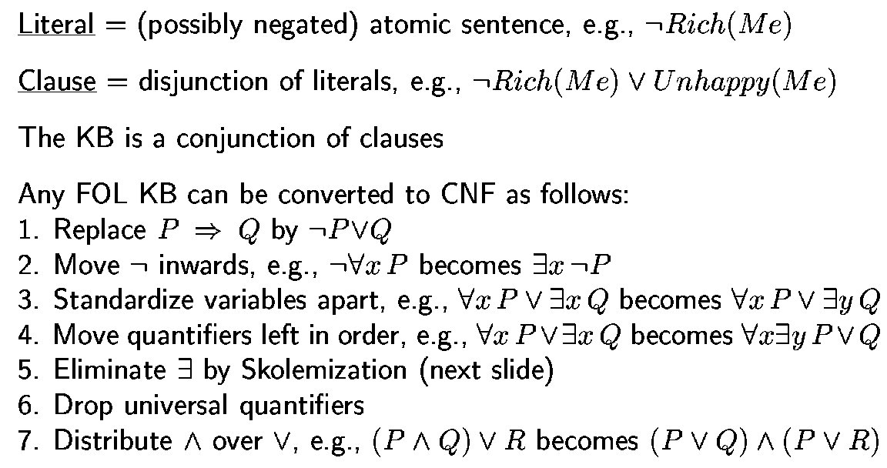
Converting to Conjunctive Normal Form (briefly)

Slide 42
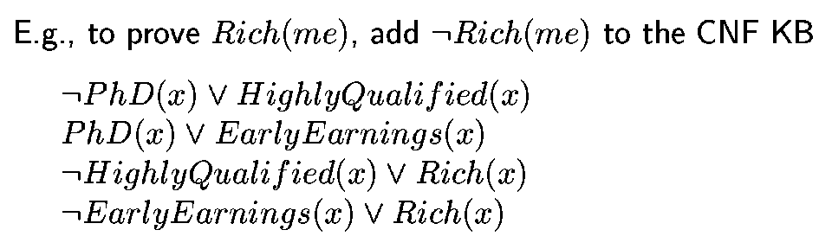
Example: Using Resolution to solve problem

Slide 43
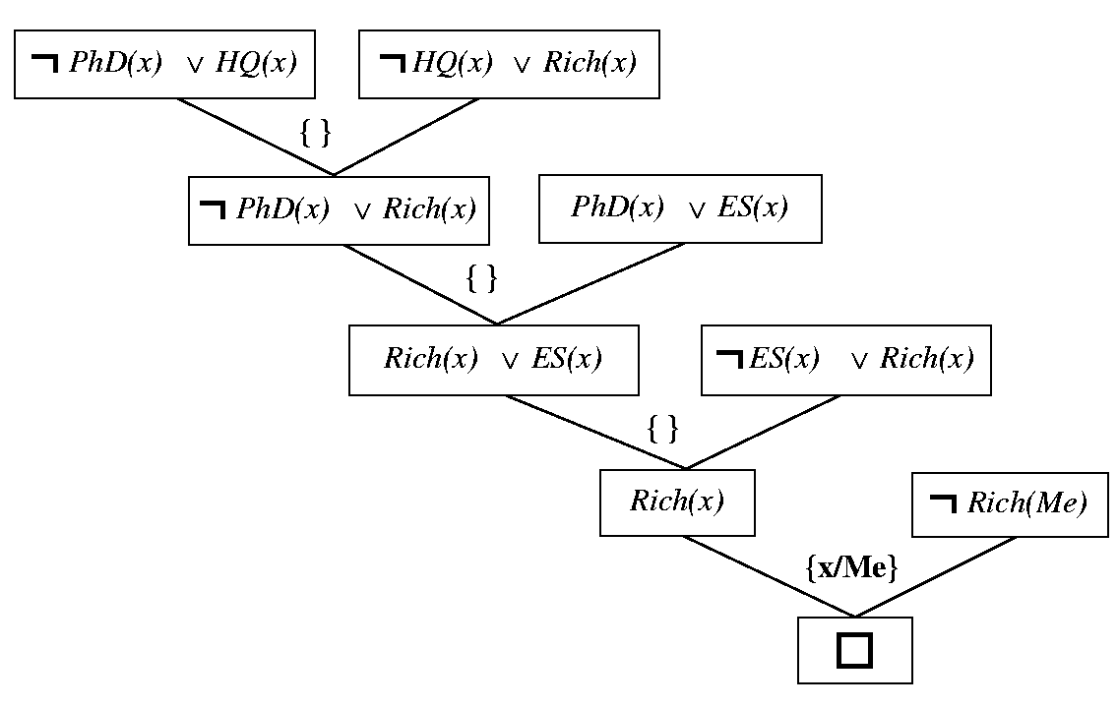
Sample Resolution Proof

Slide 44
What about Prolog?
Only Horn clause sentences
  semicolon (“or”) ok if equivalent to Horn clause
Negation as failure: not P is considered proved if system fails to prove P
Backward chaining with depth-first search
Order of search is first to last, left to right
Built in predicates for arithmetic
  X is Y*Z+3
Depth-first search could result in infinite looping

Slide 45
Theorem Provers
Theorem provers are different from logic programming languages
  Handle all first-order logic, not just Horn clauses
  Can write logic in any order, no control issue

Slide 46
Sample theorem prover: Otter
Define facts (set of support)
Define usable axioms (basic background)
Define rules (rewrites or demodulators)
Heuristic function to control search
  Sample heuristic: small and simple statements are better
OTTER works by doing best first search
http://www-unix.mcs.anl.gov/AR/sobb/
  Boolean algebras

